Slide 1
The NXT Circuit
U2C2

Slide 2
2.2 The NXT Circuit
Overview:
This lesson explores the NXT from an electrical circuit perspective. It is intended to follow the "Circuits and Switches" lesson.
Objectives: Students will be able to:
1. Describe the NXT components that make up the four parts of a NXT circuit
2. Name NXT components that are examples of Insulators, Conductors and Semiconductors

Slide 3
Worksheet
The NXT Circuits
Name:___________________ Period:___ Date:_____ Score:__/15
1. Name the four parts of a circuit:
2. Identify the four parts of a circuit in an NXT circuit of your choice:
3. Briefly describe each of the four parts:
4. What are the characteristics of an insulator, conductor and semiconductor.
5. Give an example of an insulator, conductor and semiconductor in an NXT circuit
Notes:
Answer Key:
The NXT Circuit_Unit Level [1]
Submitted by Randy Steele [2] on 11 July, 2011 - 07:42
Answer Key:
1. Name the four parts of a circuit:
Power source – a battery (many possible answers)
Conducting path – a wire (many possible answers)
Switch – a light switch (many possible answers)
Load – light bulb (many possible answers)
2. Identify the four parts of a circuit in an NXT circuit of your choice.
Example: NXT with a touch sensor (many possible answers):
Power Source - NXT battery
Conducting Path - NXT wires
Switch - Touch Sensor or NXT buttons
Load - NXT LCD screen or speaker
3. Briefly describe each of the four parts:
What are the characteristics of an insulator, conductor and semiconductor.
Insulator – plastic on the wires (many possible answers)
Conductor – metal inside wires (many possible answers)
Semiconductor – transistor, diode, LED lights (many possible answers)
5. Give an example of an insulator, conductor and semiconductor in an NXT circuit.
Insulator – plastic on the wires, brick, motors (many possible answers)
Conductor – metal inside wires, usb cable (many possible answers)
Semiconductor – brick LCD screen, battery LED lights (many possible answers)

Slide 4
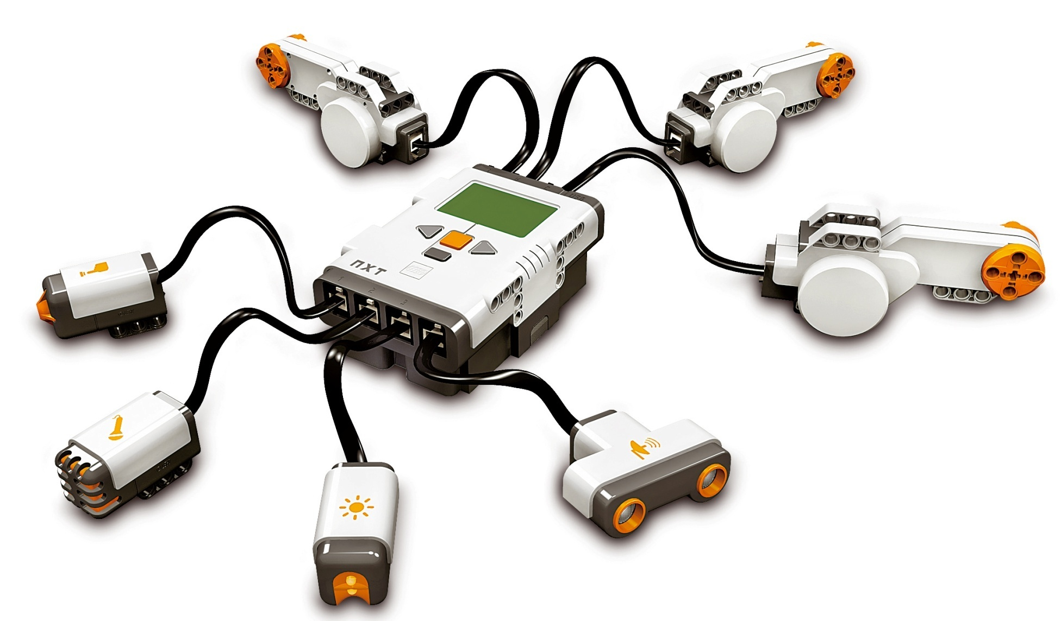
The NXT Electronics Circuit
Conductor?
Insulator?
Semiconductor?
Power Source?
Conducting Path?
Load?
Switch?
Notes:
Instruction Guide: The NXT Circuit
Submitted by Randy Steele on 10 July, 2011 - 16:12
This lesson applies the learning from the previous Circuits and Switches lesson to the particulars of the NXT.
The Four Parts of a NXT Circuit (see NXT Circuit PPT : slide 1)
Power Source – Battery
Conducting Path – Wires
Load – Motors, or other outputs (lamps, LCD screen, speaker)
Switch – NXT brick buttons, or other inputs (ultrasonic, sound and light sensors)
Ask students which sensor acts like a simple switch (Touch Sensor)
NXT Insulators, Conductors and Semiconductors
Conductors – Wires (slide 1)
Insulators – Plastic covers on electronic components
Semiconductors – Not as obvious from the outside
LED’s on battery pack or light sensor
LCD screen on NXT brick
Mostly inside plastic housings (slide 2)
Black plastics rectangles on circuit board are semiconductor computer chips
Also found in ultrasonic, sound and light sensors
Also found in motors (slide 3)

Slide 5
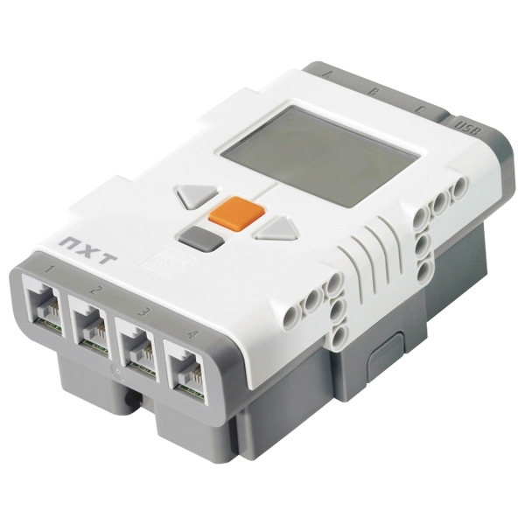
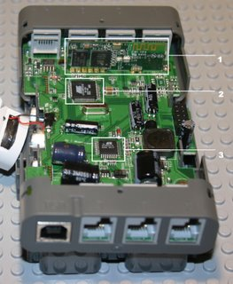
NXT Brick – Outside & Inside
Semiconductor
LCD Screen >>>
Semiconductors
Computer Chips
Notes:
Instruction Guide: The NXT Circuit
Submitted by Randy Steele on 10 July, 2011 - 16:12
This lesson applies the learning from the previous Circuits and Switches lesson to the particulars of the NXT.
The Four Parts of a NXT Circuit (see NXT Circuit PPT : slide 1)
Power Source – Battery
Conducting Path – Wires
Load – Motors, or other outputs (lamps, LCD screen, speaker)
Switch – NXT brick buttons, or other inputs
Ask students which sensor acts like a simple switch (Touch Sensor)
NXT Insulators, Conductors and Semiconductors
Conductors – Wires (slide 1)
Insulators – Plastic covers on electronic components
Semiconductors – Not as obvious from the outside
LED’s on battery pack or light sensor
LCD screen on NXT brick
Mostly inside plastic housings (slide 2)
Black plastics rectangles on circuit board are semiconductor computer chips
Also found in ultrasonic, sound and light sensors
Also found in motors (slide 3)

Slide 6
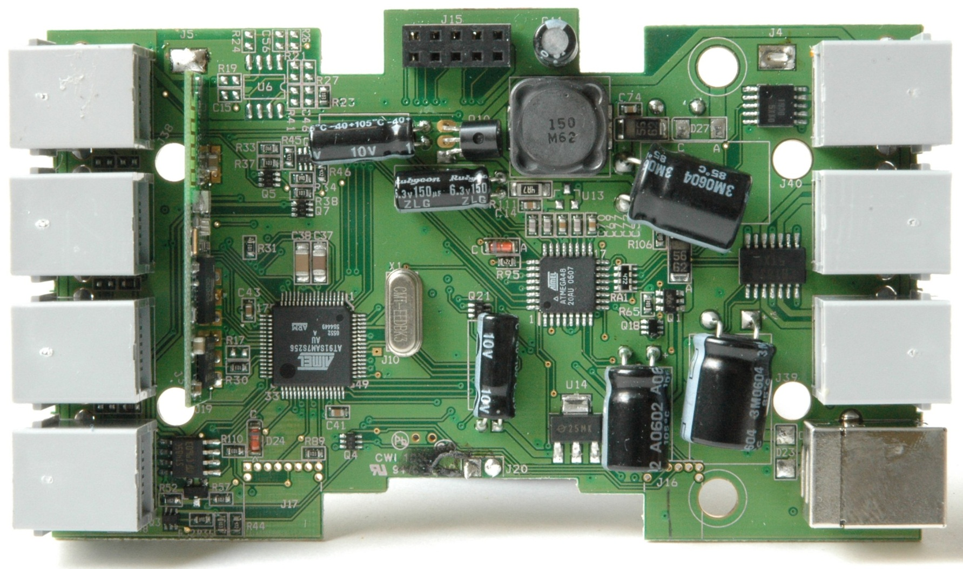
NXT Brick –Inside
Notes:
Pictures of NXT Production Hardware
Here are some pictures of the hardware of a production NXT.
This is a view of the top of the motherboard. According to the schematics released by LEGO the part missing in the upper right was a battery current sensor on AD5. The black smudge at the square speaker connector covered an additional part in the speaker cable, a 10 Ohm resistor which is not in the schematics. I unsoldered it together with the speaker cable to get the LCD daughter board out of the way for photographing the motherboard
http://www.jstuber.net/lego/nxt-programming/nxt-hardware.html

Slide 7
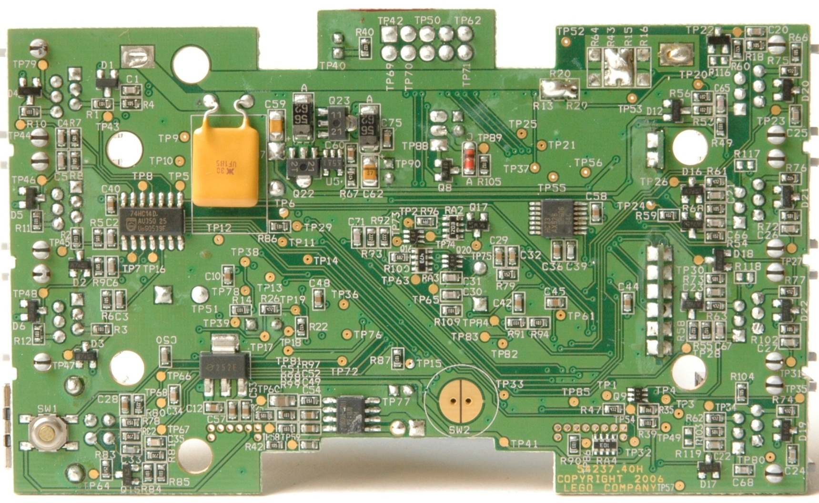
NXT Brick –Inside
Notes:
Pictures of NXT Production Hardware
Here are some pictures of the hardware of a production NXT.
This is the bottom of the motherboard. Note that RA4 and R90, the pull-up resistors for the JTAG connector J17, are still present (thanks LEGO!), like in the prototype version.
http://www.jstuber.net/lego/nxt-programming/nxt-hardware.html

Slide 8
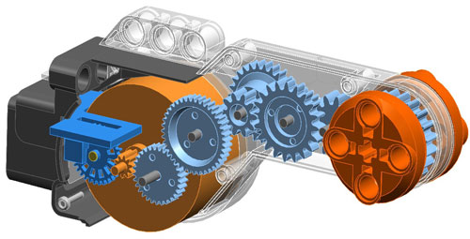
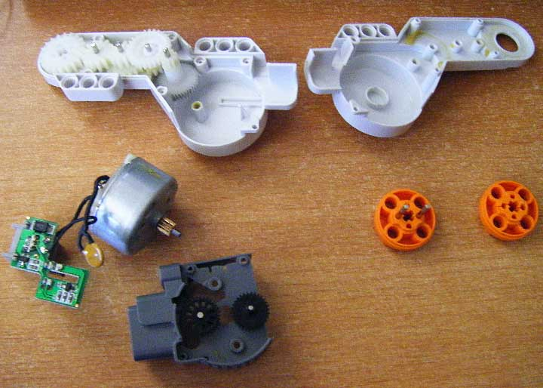
NXT Motor – Inside
These NXT parts also have
semiconductors inside them:
Ultrasonic sensor
Sound sensor
Light sensor
Battery
Semiconductors >>>>>>>>>>
Computer Chips
  Motor Encoders
    Track how much
    the motor has turned
Notes:
Instruction Guide: The NXT Circuit
Submitted by Randy Steele on 10 July, 2011 - 16:12
This lesson applies the learning from the previous Circuits and Switches lesson to the particulars of the NXT.
The Four Parts of a NXT Circuit (see NXT Circuit PPT : slide 1)
Power Source – Battery
Conducting Path – Wires
Load – Motors, or other outputs (lamps, LCD screen, speaker)
Switch – NXT brick buttons, or other inputs
Ask students which sensor acts like a simple switch (Touch Sensor)
NXT Insulators, Conductors and Semiconductors
Conductors – Wires (slide 1)
Insulators – Plastic covers on electronic components
Semiconductors – Not as obvious from the outside
LED’s on battery pack or light sensor
LCD screen on NXT brick
Mostly inside plastic housings (slide 2)
Black plastics rectangles on circuit board are semiconductor computer chips
Also found in ultrasonic, sound and light sensors
Also found in motors (slide 3)

Slide 9
The NXT Electronics Circuit
Power Source?
Conducting Path?
Load?
Switch?
Notes:
Instruction Guide: The NXT Circuit
Submitted by Randy Steele on 10 July, 2011 - 16:12
This lesson applies the learning from the previous Circuits and Switches lesson to the particulars of the NXT.
The Four Parts of a NXT Circuit (see NXT Circuit PPT : slide 1)
Power Source – Battery
Conducting Path – Wires
Load – Motors, or other outputs (lamps, LCD screen, speaker)
Switch – NXT brick buttons, or other inputs
Ask students which sensor acts like a simple switch (Touch Sensor)
NXT Insulators, Conductors and Semiconductors
Conductors – Wires (slide 1)
Insulators – Plastic covers on electronic components
Semiconductors – Not as obvious from the outside
LED’s on battery pack or light sensor
LCD screen on NXT brick
Mostly inside plastic housings (slide 2)
Black plastics rectangles on circuit board are semiconductor computer chips
Also found in ultrasonic, sound and light sensors
Also found in motors (slide 3)

Slide 10

Review Question 1
Which part of the 4 parts of a circuit is the Orange Button on the NXT Brick?
A) Power Source
B) Conducting Path
C) Load
D) Switch
E) None of the above
Notes:
Which part of the 4 parts of a circuit is the Orange Button on the NXT Brick?
A) Power Source
B) Conducting Path
C) Load
D) Switch
E) None of the above

Slide 11
Review Question 1
Which part of the 4 parts of a circuit is the Orange Button on the NXT Brick?
A) Power Source
B) Conducting Path
C) Load
D) Switch
E) None of the above
Notes:
Which part of the 4 parts of a circuit is the Orange Button on the NXT Brick?
A) Power Source
B) Conducting Path
C) Load
D) Switch
E) None of the above
The Four Parts of a NXT Circuit (see NXT Circuit PPT : slide 1)
Power Source – Battery
Conducting Path – Wires
Load – Motors, or other outputs (lamps, LCD screen, speaker)
Switch – NXT brick buttons, or other inputs (ultrasonic, sound and light sensors)
Ask students which sensor acts like a simple switch (Touch Sensor)

Slide 12
Review Question 2
Which part of the 4 parts of a circuit are
the Connecting Wires?
A) Power Source
B) Conducting Path
C) Load
D) Switch
E) None of the above
Notes:
Which part of the 4 parts of a circuit are
the Connecting Wires?
A) Power Source
B) Conducting Path
C) Load
D) Switch
E) None of the above

Slide 13
Review Question 2
Which part of the 4 parts of a circuit are
the Connecting Wires?
A) Power Source
B) Conducting Path
C) Load
D) Switch
E) None of the above
Notes:
Which part of the 4 parts of a circuit are
the Connecting Wires?
A) Power Source
B) Conducting Path
C) Load
D) Switch
E) None of the above
The Four Parts of a NXT Circuit (see NXT Circuit PPT : slide 1)
Power Source – Battery
Conducting Path – Wires
Load – Motors, or other outputs (lamps, LCD screen, speaker)
Switch – NXT brick buttons, or other inputs (ultrasonic, sound and light sensors)
Ask students which sensor acts like a simple switch (Touch Sensor)

Slide 14

Review Question 3
Which part of the 4 parts of a circuit is
the NXT Brick Battery?
A) Power Source
B) Conducting Path
C) Load
D) Switch
E) None of the above
Notes:
Which part of the 4 parts of a circuit is
the NXT Brick Battery?
A) Power Source
B) Conducting Path
C) Load
D) Switch
E) None of the above

Slide 15
Review Question 3
Which part of the 4 parts of a circuit is
the NXT Brick Battery?
A) Power Source
B) Conducting Path
C) Load
D) Switch
E) None of the above
Notes:
Which part of the 4 parts of a circuit is
the NXT Brick Battery?
A) Power Source
B) Conducting Path
C) Load
D) Switch
E) None of the above
The Four Parts of a NXT Circuit (see NXT Circuit PPT : slide 1)
Power Source – Battery
Conducting Path – Wires
Load – Motors, or other outputs (lamps, LCD screen, speaker)
Switch – NXT brick buttons, or other inputs (ultrasonic, sound and light sensors)
Ask students which sensor acts like a simple switch (Touch Sensor)

Slide 16
Review Question 4
Which part of the 4 parts of a circuit is
the NXT Brick Speaker?
A) Power Source
B) Conducting Path
C) Load
D) Switch
E) None of the above
Notes:
Which part of the 4 parts of a circuit is
the NXT Brick Speaker?
A) Power Source
B) Conducting Path
C) Load
D) Switch
E) None of the above

Slide 17
Review Question 4
Which part of the 4 parts of a circuit is
the NXT Brick Speaker?
A) Power Source
B) Conducting Path
C) Load
D) Switch
E) None of the above
Notes:
Which part of the 4 parts of a circuit is
the NXT Brick Speaker?
A) Power Source
B) Conducting Path
C) Load
D) Switch
E) None of the above
The Four Parts of a NXT Circuit (see NXT Circuit PPT : slide 1)
Power Source – Battery
Conducting Path – Wires
Load – Motors, or other outputs (lamps, LCD screen, speaker)
Switch – NXT brick buttons, or other inputs (ultrasonic, sound and light sensors)
Ask students which sensor acts like a simple switch (Touch Sensor)

Slide 18
Review Question 5
Which part of the 4 parts of a circuit is
the Ultrasonic Sensor?
A) Power Source
B) Conducting Path
C) Load
D) Switch
E) None of the above
Notes:
Which part of the 4 parts of a circuit is
the Ultrasonic Sensor?
A) Power Source
B) Conducting Path
C) Load
D) Switch
E) None of the above

Slide 19
Review Question 5
Which part of the 4 parts of a circuit is
the Ultrasonic Sensor?
A) Power Source
B) Conducting Path
C) Load
D) Switch
E) None of the above
Notes:
Which part of the 4 parts of a circuit is
the Ultrasonic Sensor?
A) Power Source
B) Conducting Path
C) Load
D) Switch
E) None of the above
The Four Parts of a NXT Circuit (see NXT Circuit PPT : slide 1)
Power Source – Battery
Conducting Path – Wires
Load – Motors, or other outputs (lamps, LCD screen, speaker)
Switch – NXT brick buttons, or other inputs (ultrasonic, sound and light sensors)
Ask students which sensor acts like a simple switch (Touch Sensor)

Slide 20
Review Question 6
Which part of the 4 parts of a circuit is
the USB Cable?
A) Power Source
B) Conducting Path
C) Load
D) Switch
E) None of the above
Notes:
Which part of the 4 parts of a circuit is
the USB Cable?
A) Power Source
B) Conducting Path
C) Load
D) Switch
E) None of the above

Slide 21
Review Question 6
Which part of the 4 parts of a circuit is
the USB Cable?
A) Power Source
B) Conducting Path
C) Load
D) Switch
E) None of the above
Notes:
Which part of the 4 parts of a circuit is
the USB Cable?
A) Power Source
B) Conducting Path
C) Load
D) Switch
E) None of the above
The Four Parts of a NXT Circuit (see NXT Circuit PPT : slide 1)
Power Source – Battery
Conducting Path – Wires
Load – Motors, or other outputs (lamps, LCD screen, speaker)
Switch – NXT brick buttons, or other inputs (ultrasonic, sound and light sensors)
Ask students which sensor acts like a simple switch (Touch Sensor)

Slide 22
Review Question 7
Which part of the 4 parts of a circuit is
a 15-hole Beam?
A) Power Source
B) Conducting Path
C) Load
D) Switch
E) None of the above
Notes:
Which part of the 4 parts of a circuit is
a 15-hole Beam?
A) Power Source
B) Conducting Path
C) Load
D) Switch
E) None of the above

Slide 23
Review Question 7
Which part of the 4 parts of a circuit is
a 15-hole Beam?
A) Power Source
B) Conducting Path
C) Load
D) Switch
E) None of the above
Notes:
Which part of the 4 parts of a circuit is
a 15-hole Beam?
A) Power Source
B) Conducting Path
C) Load
D) Switch
E) None of the above
The Four Parts of a NXT Circuit (see NXT Circuit PPT : slide 1)
Power Source – Battery
Conducting Path – Wires
Load – Motors, or other outputs (lamps, LCD screen, speaker)
Switch – NXT brick buttons, or other inputs (ultrasonic, sound and light sensors)
Ask students which sensor acts like a simple switch (Touch Sensor)

Slide 24
Review Question 8
Which part of the 4 parts of a circuit is
a Motor?
A) Power Source
B) Conducting Path
C) Load
D) Switch
E) None of the above
Notes:
Which part of the 4 parts of a circuit is
a Motor?
A) Power Source
B) Conducting Path
C) Load
D) Switch
E) None of the above

Slide 25
Review Question 8
Which part of the 4 parts of a circuit is
a Motor?
A) Power Source
B) Conducting Path
C) Load
D) Switch
E) None of the above
Notes:
Which part of the 4 parts of a circuit is
a Motor?
A) Power Source
B) Conducting Path
C) Load
D) Switch
E) None of the above
The Four Parts of a NXT Circuit (see NXT Circuit PPT : slide 1)
Power Source – Battery
Conducting Path – Wires
Load – Motors, or other outputs (lamps, LCD screen, speaker)
Switch – NXT brick buttons, or other inputs (ultrasonic, sound and light sensors)
Ask students which sensor acts like a simple switch (Touch Sensor)

Slide 26
Review Question 9
Which part of the 4 parts of a circuit is
a Touch Sensor?
A) Power Source
B) Conducting Path
C) Load
D) Switch
E) None of the above
Notes:
Which part of the 4 parts of a circuit is
a Touch Sensor?
A) Power Source
B) Conducting Path
C) Load
D) Switch
E) None of the above

Slide 27
Review Question 9
Which part of the 4 parts of a circuit is
a Touch Sensor?
A) Power Source
B) Conducting Path
C) Load
D) Switch
E) None of the above
Notes:
Which part of the 4 parts of a circuit is
a Touch Sensor?
A) Power Source
B) Conducting Path
C) Load
D) Switch
E) None of the above
The Four Parts of a NXT Circuit (see NXT Circuit PPT : slide 1)
Power Source – Battery
Conducting Path – Wires
Load – Motors, or other outputs (lamps, LCD screen, speaker)
Switch – NXT brick buttons, or other inputs (ultrasonic, sound and light sensors)
Ask students which sensor acts like a simple switch (Touch Sensor)

Slide 28
The NXT Electronics Circuit
Conductor?
Insulator?
Semiconductor?
Notes:
Instruction Guide: The NXT Circuit
Submitted by Randy Steele on 10 July, 2011 - 16:12
This lesson applies the learning from the previous Circuits and Switches lesson to the particulars of the NXT.
The Four Parts of a NXT Circuit (see NXT Circuit PPT : slide 1)
Power Source – Battery
Conducting Path – Wires
Load – Motors, or other outputs (lamps, LCD screen, speaker)
Switch – NXT brick buttons, or other inputs (ultrasonic, sound and light sensors)
Ask students which sensor acts like a simple switch (Touch Sensor)
NXT Insulators, Conductors and Semiconductors
Conductors – Wires (slide 1)
Insulators – Plastic covers on electronic components
Semiconductors – Not as obvious from the outside
LED’s on battery pack or light sensor
LCD screen on NXT brick
Mostly inside plastic housings (slide 2)
Black plastics rectangles on circuit board are semiconductor computer chips
Also found in ultrasonic, sound and light sensors
Also found in motors (slide 3)

Slide 29
NXT Brick – Outside & Inside
Semiconductor
LCD Screen >>>
Semiconductors
Computer Chips
Notes:
Instruction Guide: The NXT Circuit
Submitted by Randy Steele on 10 July, 2011 - 16:12
This lesson applies the learning from the previous Circuits and Switches lesson to the particulars of the NXT.
The Four Parts of a NXT Circuit (see NXT Circuit PPT : slide 1)
Power Source – Battery
Conducting Path – Wires
Load – Motors, or other outputs (lamps, LCD screen, speaker)
Switch – NXT brick buttons, or other inputs
Ask students which sensor acts like a simple switch (Touch Sensor)
NXT Insulators, Conductors and Semiconductors
Conductors – Wires (slide 1)
Insulators – Plastic covers on electronic components
Semiconductors – Not as obvious from the outside
LED’s on battery pack or light sensor
LCD screen on NXT brick
Mostly inside plastic housings (slide 2)
Black plastics rectangles on circuit board are semiconductor computer chips
Also found in ultrasonic, sound and light sensors
Also found in motors (slide 3)

Slide 30
NXT Motor – Inside
These NXT parts also have
semiconductors inside them:
Ultrasonic sensor
Sound sensor
Light sensor
Battery
Semiconductors >>>>>>>>>>
Computer Chips
  Motor Encoders
    Track how much
    the motor has turned
Notes:
Instruction Guide: The NXT Circuit
Submitted by Randy Steele on 10 July, 2011 - 16:12
This lesson applies the learning from the previous Circuits and Switches lesson to the particulars of the NXT.
The Four Parts of a NXT Circuit (see NXT Circuit PPT : slide 1)
Power Source – Battery
Conducting Path – Wires
Load – Motors, or other outputs (lamps, LCD screen, speaker)
Switch – NXT brick buttons, or other inputs
Ask students which sensor acts like a simple switch (Touch Sensor)
NXT Insulators, Conductors and Semiconductors
Conductors – Wires (slide 1)
Insulators – Plastic covers on electronic components
Semiconductors – Not as obvious from the outside
LED’s on battery pack or light sensor
LCD screen on NXT brick
Mostly inside plastic housings (slide 2)
Black plastics rectangles on circuit board are semiconductor computer chips
Also found in ultrasonic, sound and light sensors
Also found in motors (slide 3)

Slide 31
Review Question 1
A Conductor lets electricity flow…..
A) all the time
B) only under certain
conditions
C) never
D) None of the above
Notes:
A Conductor lets electricity flow…..
A) all the time
B) only under certain conditions
C) never
D) None of the above

Slide 32
Review Question 1
A Conductor lets electricity flow…..
A) all the time
B) only under certain
conditions
C) never
D) None of the above
Notes:
A Conductor lets electricity flow…..
A) all the time
B) only under certain conditions
C) never
D) None of the above
NXT Insulators, Conductors and Semiconductors
Conductors – Wires (slide 1)
Insulators – Plastic covers on electronic components
Semiconductors – Not as obvious from the outside
LED’s on battery pack or light sensor
LCD screen on NXT brick
Mostly inside plastic housings (slide 2)
Black plastics rectangles on circuit board are semiconductor computer chips
Also found in ultrasonic, sound and light sensors
Also found in motors (slide 3)

Slide 33
Review Question 2
An Insulator lets electricity flow…..
A) all the time
B) only under certain
conditions
C) never
D) None of the above
Notes:
An Insulator lets electricity flow…..
A) all the time
B) only under certain conditions
C) never
D) None of the above

Slide 34
Review Question 2
An Insulator lets electricity flow…..
A) all the time
B) only under certain
conditions
C) never
D) None of the above
Notes:
An Insulator lets electricity flow…..
A) all the time
B) only under certain conditions
C) never
D) None of the above
NXT Insulators, Conductors and Semiconductors
Conductors – Wires (slide 1)
Insulators – Plastic covers on electronic components
Semiconductors – Not as obvious from the outside
LED’s on battery pack or light sensor
LCD screen on NXT brick
Mostly inside plastic housings (slide 2)
Black plastics rectangles on circuit board are semiconductor computer chips
Also found in ultrasonic, sound and light sensors
Also found in motors (slide 3)

Slide 35
Review Question 3
A Semiconductor lets electricity flow…..
A) all the time
B) only under certain
conditions
C) never
D) None of the above
Notes:
A Semiconductor lets electricity flow…..
A) all the time
B) only under certain conditions
C) never
D) None of the above

Slide 36
Review Question 3
A Semiconductor lets electricity flow…..
A) all the time
B) only under certain
conditions
C) never
D) None of the above
Notes:
A Semiconductor lets electricity flow…..
A) all the time
B) only under certain conditions
C) never
D) None of the above

Slide 37
Review Question 4
Which of these parts of an NXT circuit
contains a Conductor?
A) The NXT Brick
B) The Connecting
Wires
C) The Touch Sensor
D) All of the above
Notes:
Which of these parts of an NXT circuit
contains a Conductor?
A) The NXT Brick
B) The Connecting Wires
C) The Touch Sensor
D) All of the above

Slide 38
Review Question 4
Which of these parts of an NXT circuit
contains a Conductor?
A) The NXT Brick
B) The Connecting
Wires
C) The Touch Sensor
D) All of the above
Notes:
Which of these parts of an NXT circuit
contains a Conductor?
A) The NXT Brick
B) The Connecting Wires
C) The Touch Sensor
D) All of the above
NXT Insulators, Conductors and Semiconductors
Conductors – Wires (slide 1)
Insulators – Plastic covers on electronic components
Semiconductors – Not as obvious from the outside
LED’s on battery pack or light sensor
LCD screen on NXT brick
Mostly inside plastic housings (slide 2)
Black plastics rectangles on circuit board are semiconductor computer chips
Also found in ultrasonic, sound and light sensors
Also found in motors (slide 3)

Slide 39
Review Question 5
Which of these parts of an NXT circuit
contains Insulators?
A) The NXT Brick
B) The Connecting
Wires
C) The Touch Sensor
D) All of the above
Notes:
Which of these parts of an NXT circuit
contains Insulators?
A) The NXT Brick
B) The Connecting Wires
C) The Touch Sensor
D) All of the above

Slide 40
Review Question 5
Which of these parts of an NXT circuit
contains Insulators?
A) The NXT Brick
B) The Connecting
Wires
C) The Touch Sensor
D) All of the above
Notes:
Which of these parts of an NXT circuit
contains Insulators?
A) The NXT Brick
B) The Connecting Wires
C) The Touch Sensor
D) All of the above

Slide 41
Review Question 6
Which of these parts of an NXT circuit
contains Semiconductors?
A) The NXT Brick
B) The Connecting
Wires
C) The Touch Sensor
D) All of the above
Notes:
Which of these parts of an NXT circuit
contains Semiconductors?
A) The NXT Brick
B) The Connecting Wires
C) The Touch Sensor
D) All of the above

Slide 42
Review Question 6
Which of these parts of an NXT circuit
contains Semiconductors?
A) The NXT Brick
B) The Connecting
Wires
C) The Touch Sensor
D) All of the above
Notes:
Which of these parts of an NXT circuit
contains Semiconductors?
A) The NXT Brick
B) The Connecting Wires
C) The Touch Sensor
D) All of the above
NXT Insulators, Conductors and Semiconductors
Conductors – Wires (slide 1)
Insulators – Plastic covers on electronic components
Semiconductors – Not as obvious from the outside
LED’s on battery pack or light sensor
LCD screen on NXT brick
Mostly inside plastic housings (slide 2)
Black plastics rectangles on circuit board are semiconductor computer chips
Also found in ultrasonic, sound and light sensors
Also found in motors (slide 3)

Slide 43
Review Question 7
Which of these is an example of a Semiconductor
in the NXT system?
A) The Brick LCD screen
B) The Battery LED light
C) The Motor Encoder
D) The Brick’s “Brain”
E) All of the above
Notes:
Which of these is an example of a Semiconductor
in the NXT system?
A) The Brick LCD screen
B) The Battery LED light
C) The Motor Encoder
D) The Brick’s “Brain”
E) All of the above

Slide 44
Review Question 7
Which of these is an example of a Semiconductor
in the NXT system?
A) The Brick LCD screen
B) The Battery LED light
C) The Motor Encoder
D) The Brick’s “Brain”
E) All of the above
Notes:
Which of these is an example of a Semiconductor
in the NXT system?
A) The Brick LCD screen
B) The Battery LED light
C) The Motor Encoder
D) The Brick’s “Brain”
E) All of the above
NXT Insulators, Conductors and Semiconductors
Conductors – Wires (slide 1)
Insulators – Plastic covers on electronic components
Semiconductors – Not as obvious from the outside
LED’s on battery pack or light sensor
LCD screen on NXT brick
Mostly inside plastic housings (slide 2)
Black plastics rectangles on circuit board are semiconductor computer chips
Also found in ultrasonic, sound and light sensors
Also found in motors (slide 3)

Slide 45
Worksheet
The NXT Circuits
Name:___________________ Period:___ Date:_____ Score:__/15
1. Name the four parts of a circuit:
2. Identify the four parts of a circuit in an NXT circuit of your choice:
3. Briefly describe each of the four parts:
4. What are the characteristics of an insulator, conductor and semiconductor.
5. Give an example of an insulator, conductor and semiconductor in an NXT circuit
Notes:
Answer Key:
The NXT Circuit_Unit Level [1]
Submitted by Randy Steele [2] on 11 July, 2011 - 07:42
Answer Key:
1. Name the four parts of a circuit:
Power source – a battery (many possible answers)
Conducting path – a wire (many possible answers)
Switch – a light switch (many possible answers)
Load – light bulb (many possible answers)
2. Identify the four parts of a circuit in an NXT circuit of your choice.
Example: NXT with a touch sensor (many possible answers):
Power Source - NXT battery
Conducting Path - NXT wires
Switch - Touch Sensor or NXT buttons
Load - NXT LCD screen or speaker
3. Briefly describe each of the four parts:
What are the characteristics of an insulator, conductor and semiconductor.
Insulator – plastic on the wires (many possible answers)
Conductor – metal inside wires (many possible answers)
Semiconductor – transistor, diode, LED lights (many possible answers)
5. Give an example of an insulator, conductor and semiconductor in an NXT circuit.
Insulator – plastic on the wires, brick, motors (many possible answers)
Conductor – metal inside wires, usb cable (many possible answers)
Semiconductor – brick LCD screen, battery LED lights (many possible answers)

Slide 46
Circuits & Computers - Review
Jeopardy
Notes:
This is the Unit review. Only the Circuits and The NXT columns are covered in lessons 2.1 & 2.2.
“I only have my class “question” the Circuit & The NXT column answers. They all want to try the rest but I tell them those columns will be used when we get to the lessons that cover that material. An effective Hook ☺ “ Roger Hull

Slide 47
Transistors
Assembling Transistor Radios 1955 (2:36)
http://www.youtube.com/watch?v=kKln6zTy4C8&feature=player_detailpage
How the first transistor worked (4:46)
http://www.youtube.com/watch?v=RdYHljZi7ys&feature=player_detailpage
Does the first transistor ever built still work? (3:00)
http://www.youtube.com/watch?feature=player_detailpage&v=xvrjIJw3OSU
Notes:
Assembling Transistor Radios 1955 (2:36)
http://www.youtube.com/watch?v=kKln6zTy4C8&feature=player_detailpage
A story on assembling TR-1 transistor radios, the first transistor radio made, in the 1950s at the Regency factory at Lawrence,Indiana.
How the first transistor worked (4:46)
http://www.youtube.com/watch?v=RdYHljZi7ys&feature=player_detailpage
Bill uses a replica of the point contact transistor built by Walter Brattain and John Bardeen at Bell Labs. On December 23, 1947 they used this device to amplify the output of a microphone and thus started the microelectronics revolution that changed the world. He describes in detail why a transistor works by highlighting the uniqueness of semiconductors in being able to transfer charge by positive and negative carriers.
Does the first transistor ever built still work? (3:00)
http://www.youtube.com/watch?feature=player_detailpage&v=xvrjIJw3OSU
Professor Bill Hammack examines the first transistor ever built - borrowed from the University of Illinois Spurlock Museum. He explains how it works, and its impact on our world today. And, also, he even tests it out using a large battery. Produced for iFoundry.

